Slide 1
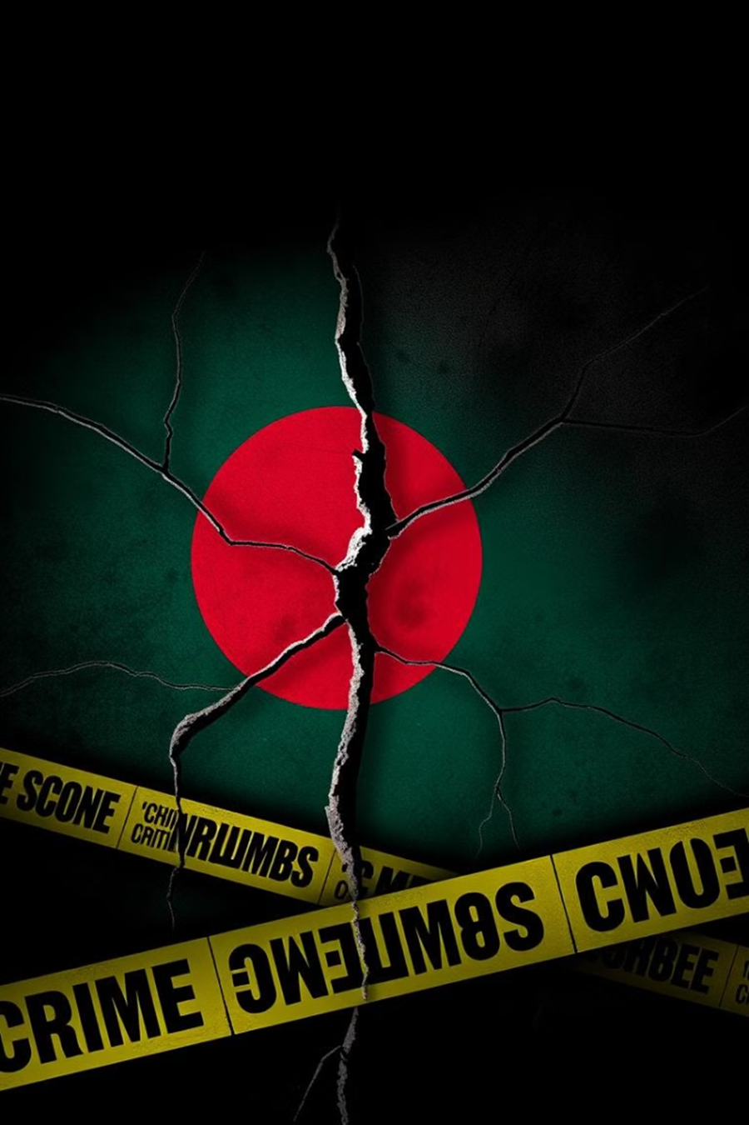

The Rising Crime Rate in Bangladesh
1)Emon Sen Dibos ID: 23201256
2) Tasnim Tabassum Meem ID: 23301480
3)Amena Akhter Akhi ID : 24101358
4) Aishee Biswas ID: 24101297
5)Fairuz Hossain Madiha ID:24104189
6)Afsara Zahir Muskaan ID:24101571
Notes:
• Bangladesh has seen a concerning rise in crime rates in recent years, which is the focus of this presentation. • The presentation team consists of 6 members, whose names and IDs are listed on the slide. • The image on the slide depicts an abstract, ominous representation of the increasing crime problem in the country. • I will provide more details on the specific crime trends and factors contributing to the rise in crime as we move through the presentation.

Slide 2
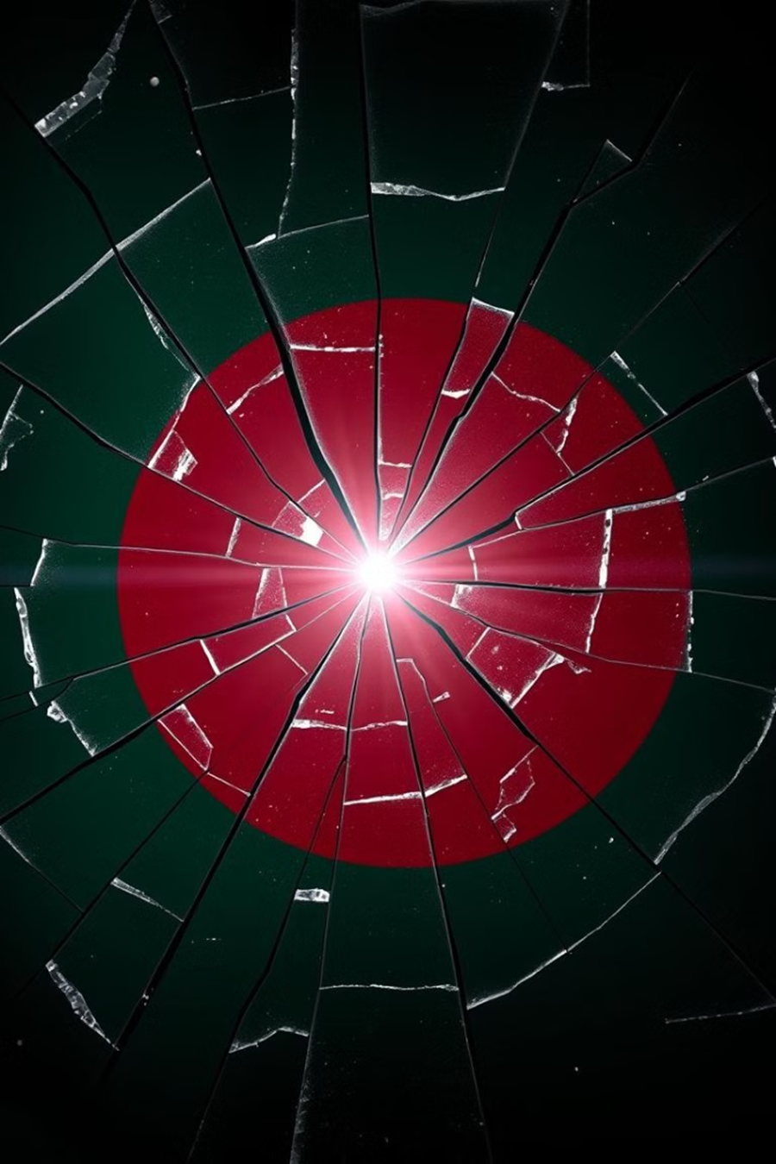


The Rising Crime Wave in Bangladesh: Stories of Pain and Injustice
Jamal (Narayanganj, February 17, 2023)
- Small business owner threatened by extortionists demanding ৳50,000 per month.
- Murdered for resisting criminal gangs.
Source: https://www.tbsnews.net/bangladesh/court/constable-titu-remanded-over-sylhet-youths-death-custody-147439?utm
Mitu (Dhaka, June 4, 2023)
-A university student, victim of a tragic crime.
- Represents the rising violence against students and women in urban areas.
Source: berkleycenter.georgetown.edu

Slide 3
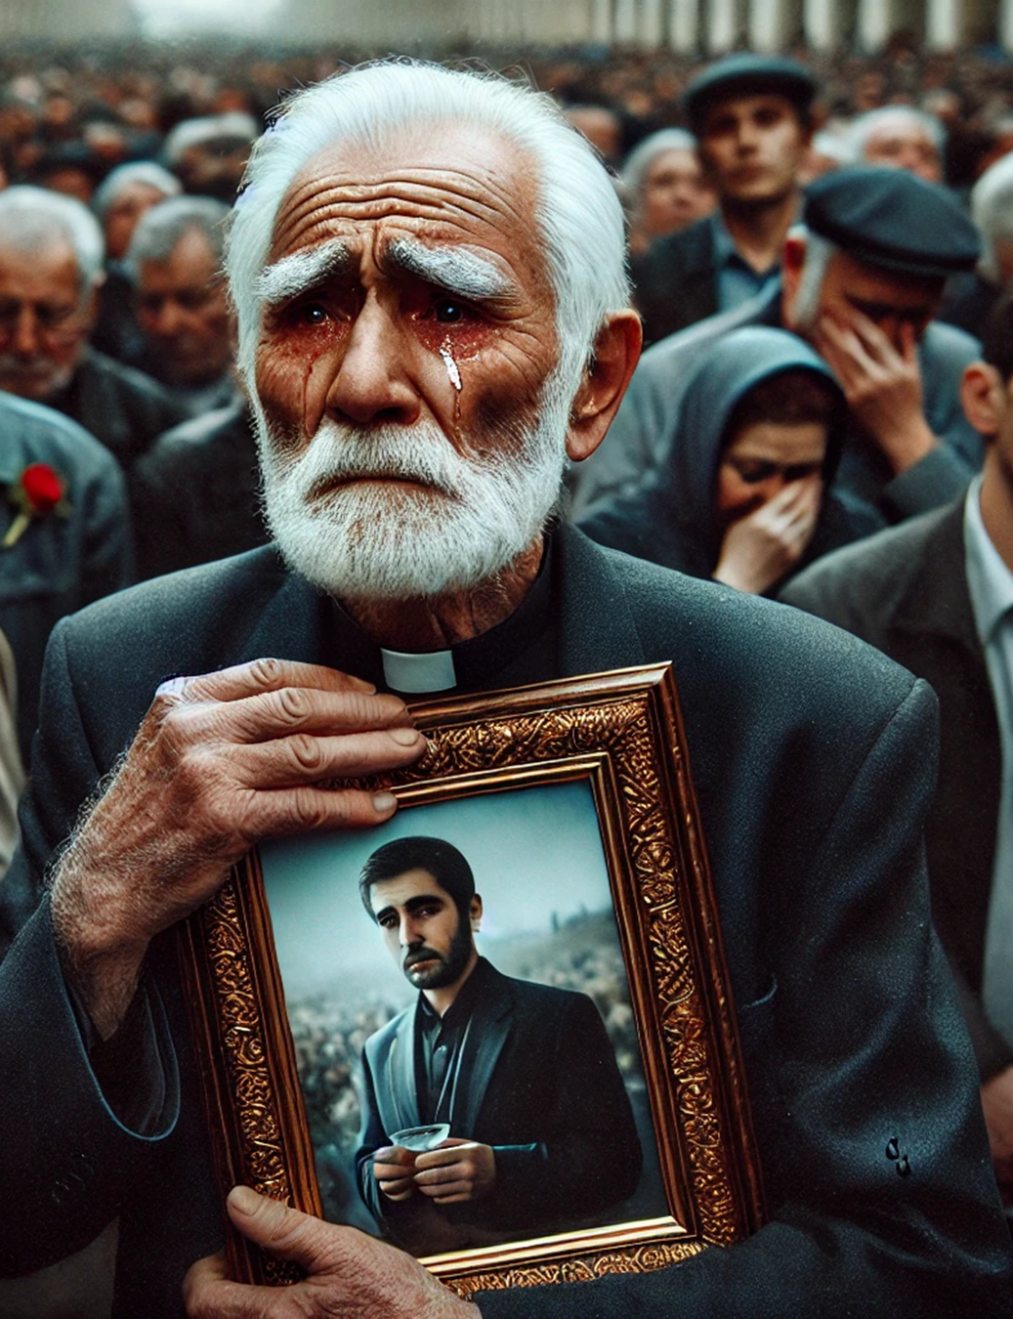

Abdul Malek's Story
Abdul Malek (Sylhet, December 10, 2023)
- His 25-year-old son, Rahim, was killed by a stray bullet in a political clash.
- Despite being an innocent bystander, he lost his life.
- The perpetrators remain free, and his father still seeks justice.
- Source: https://www.tbsnews.net/bangladesh/court/constable-titu-remanded-over-sylhet-youths-death-custody-147439?utm

Slide 4
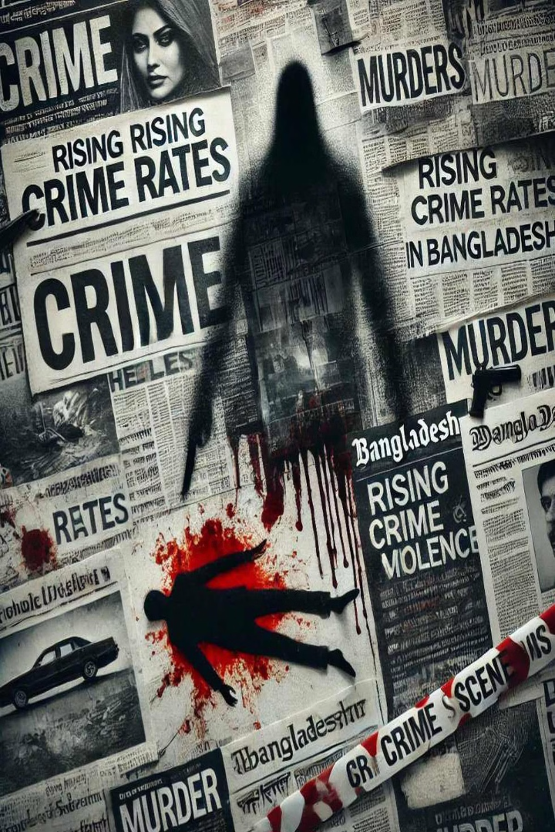
A grim reality -- Crime and justice in Bangladesh: Insights from experts.
Political Violence
ASK reports 120+ deaths, 7000+ injured in political clashes
Justice Concerns
UN Human Rights Office raises alarm on lack of accountability.
Violence Against Women
Mahila Parishad records thousands of rape & assault cases (2023).
UN states 80% of women face harrassment in public spaces.
Ranking on criminal activities
Global Crime Index (2021) ranks Bangladesh 41/193.

Slide 5

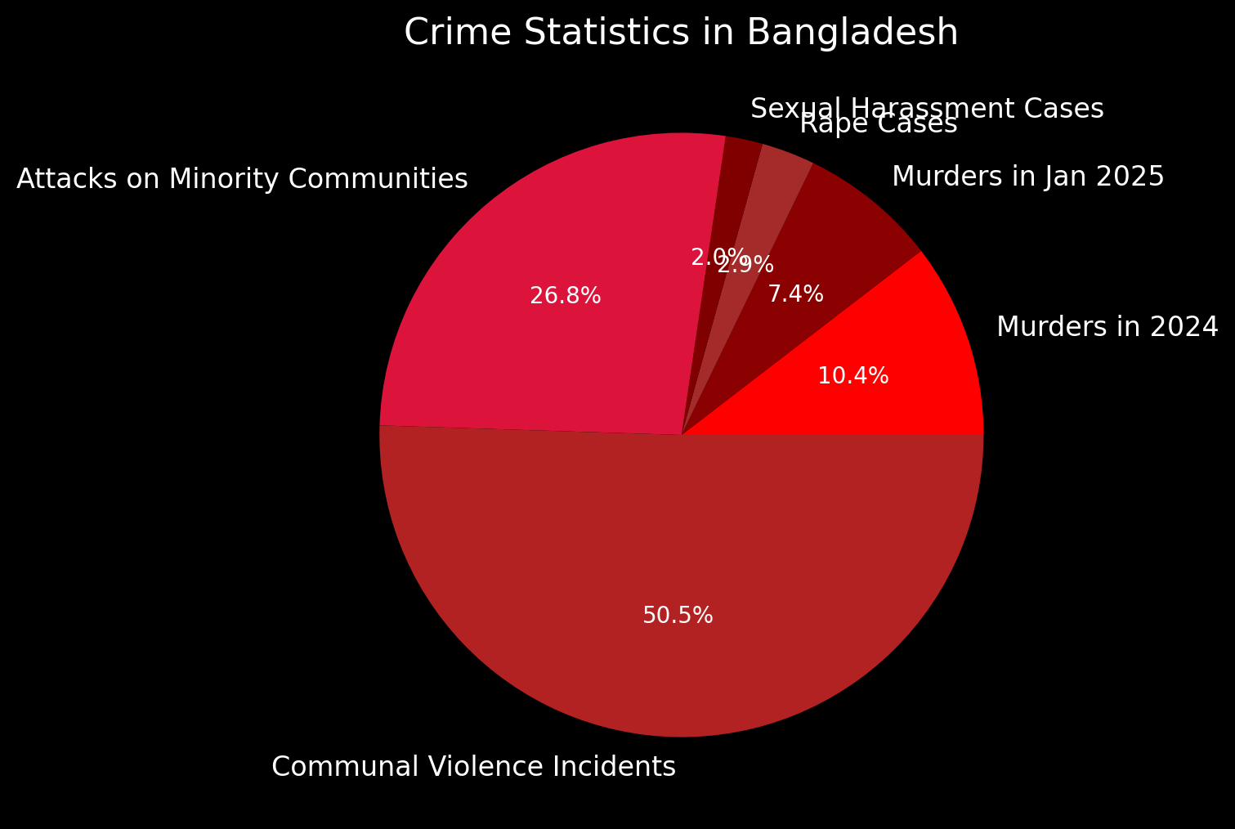

415
People were murdered in 2024
294
Murders January 2025 alone
The numbers don’t lie
114
Cases of rape were reported.
79
Cases of sexual harassment surfaced
Sexual harassment
2,010
Incidents of communal violence record
1,068
Attacks on minority communities
Sourced: The Daily star

Slide 6



Recent crime rate increase
Murder Rate Increase (2025 vs. 2020)
Increase in Sexual Violence (Past 9 Years)
The number of murders has risen by approximately 1.08 times in 2025 compared to 2020.
Sexual violence has increased by 1.3% over the past 9 years.

Slide 7
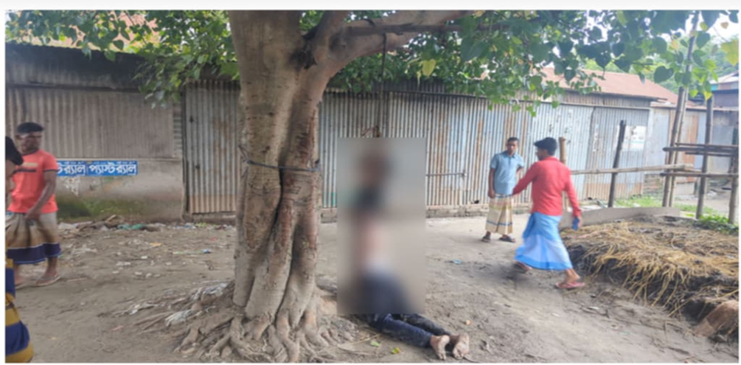
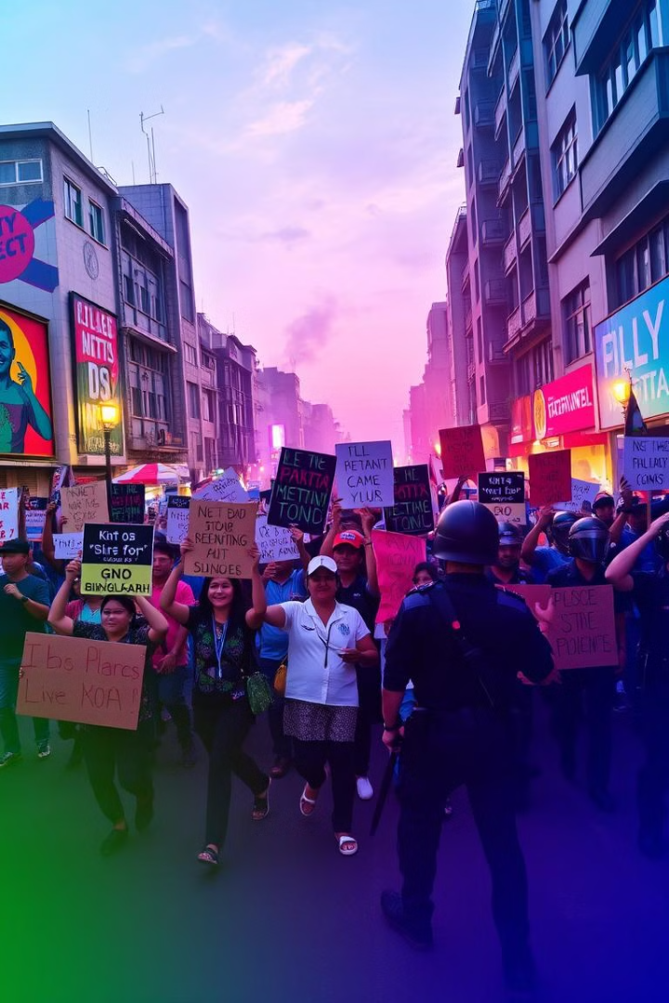
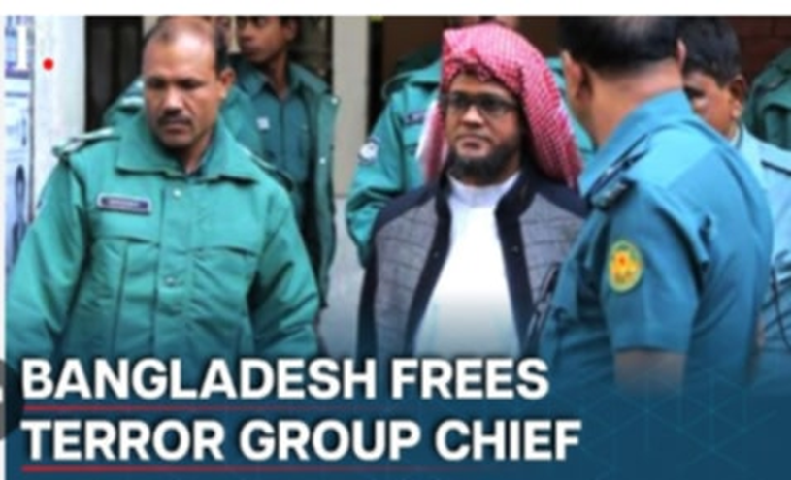
Emerging Contributors to Crime Not Seen in the Past
Killing of 13 policemen in
Sirajganj, hanging of body
Fall of former Prime Minister
1
Following the fall of former Prime Minister Sheikh Hasina on August 5, 2024, an unknown number of police were being lynched, a lot of them fled
Release of terrorist leaders
2
The interim government released a handful of terrorist group leaders

Slide 8
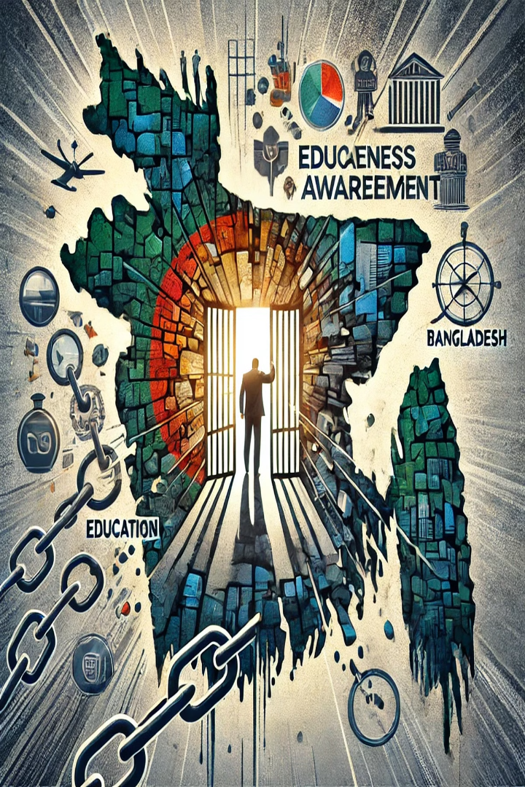




Beyond Policing: Tackling the Real Causes of Crime
Unemployment
• Limited opportunities push young people toward crime.
Corruption
• Public trust in law enforcement is low
Urbanization
• Migration to cities leads to overcrowded slums.
Political Influence
• Criminals protected by powerful figures

Slide 9

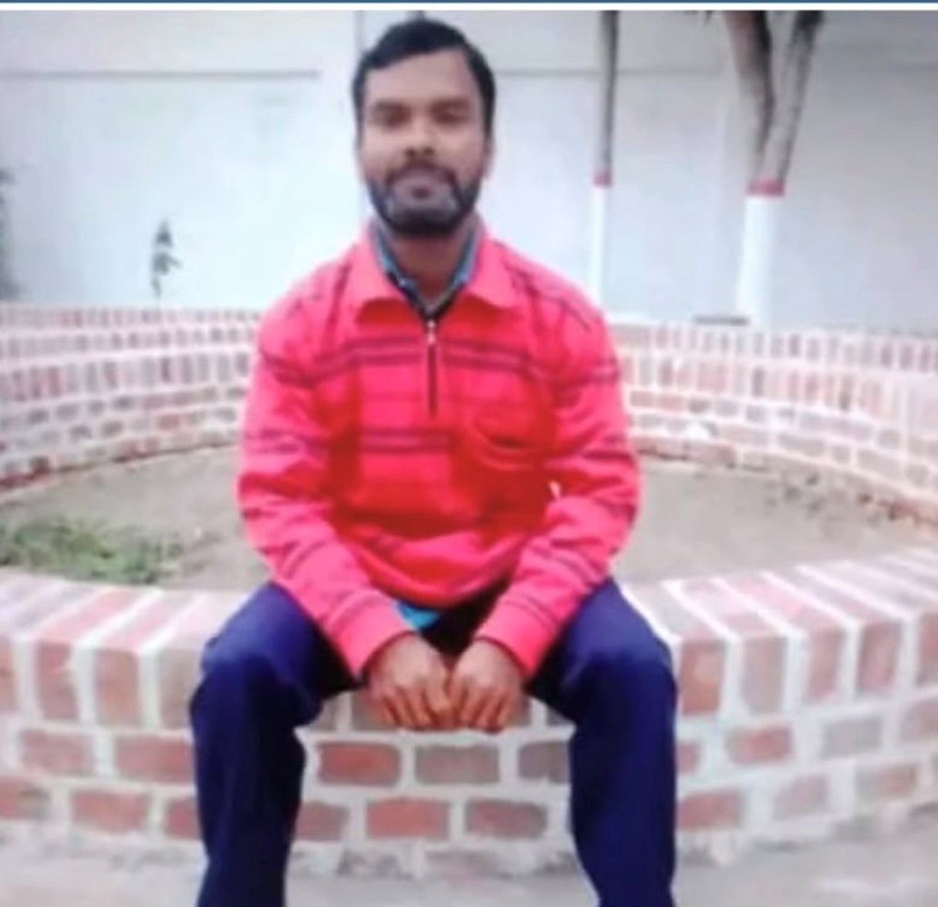
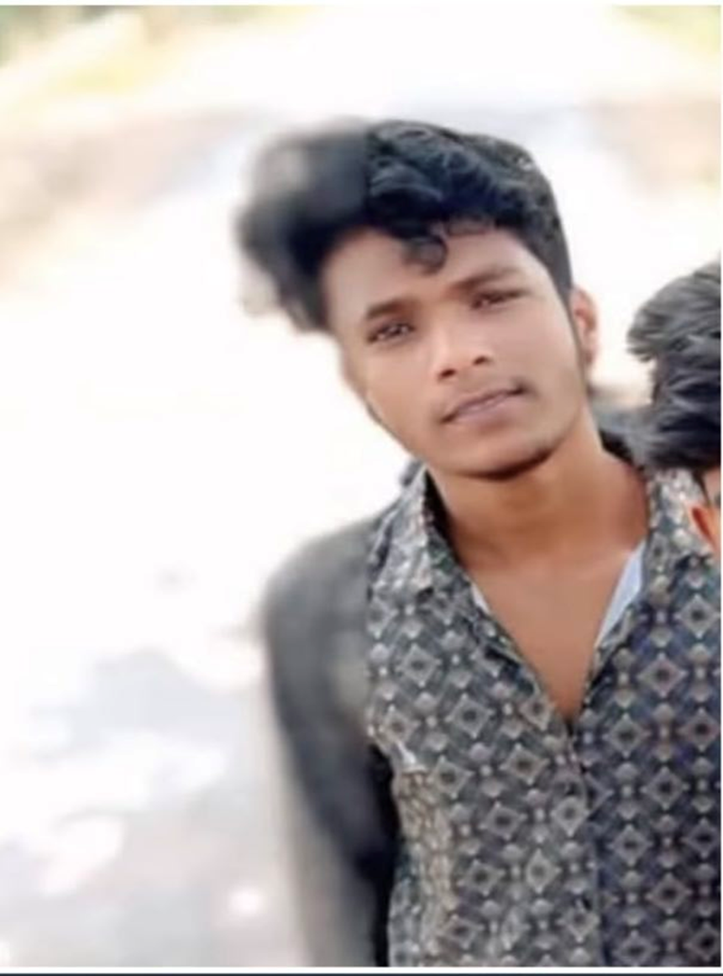
Rapists

Slide 10
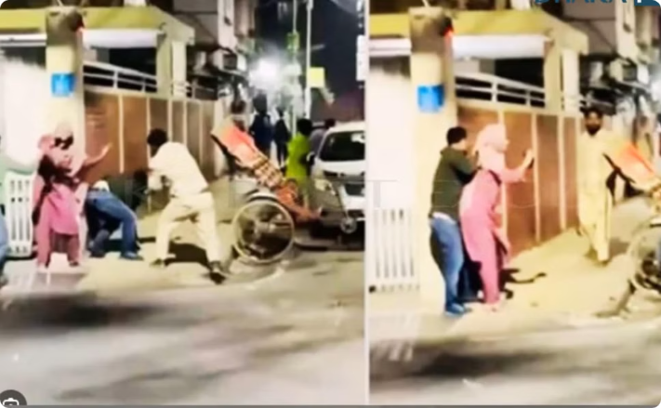
Crime Scene Documentation
Evidence Collection
Documentation of crime scenes is crucial for prosecution and justice

Slide 11
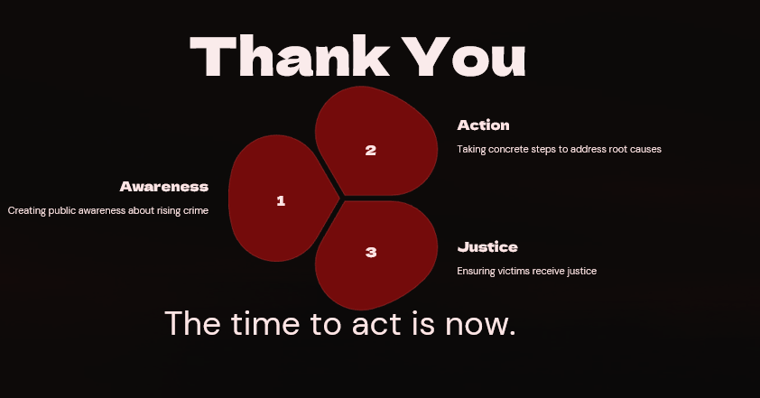




Action
2
Taking concrete steps to address root causes
Awareness
1
Creating public awareness about rising crime
3
Justice
Ensuring victims receive justice
The time to act is now.
Thank You

Slide 12


